Slide 1
Product Owner
Scrum Master
Meets with users and stakeholders
Develops User Stories and Product Backlog
Organizes and facilitates meetings; sprint planning, and daily stand-ups
Acts as mediator in daily stand-ups
In sprint planning works with team to make certain they understand the product backlog and user stories
Assists Product Owner with product backlog and user stories
Developer
Tester
Participates in daily stand-ups and sprint planning
Contributes by noting to team successes and struggles
In sprint planning works with team to decide size and time to develop features of the product
Develops features for product using the user stories and product backlog
Participates in daily stand-ups and sprint planning
Contributes by noting to team successes and struggles
In sprint planning works with team to decide size and time to develop features of the product
Develops test to confirm functionality of product features as they’re being developed
Citation 1

Slide 2
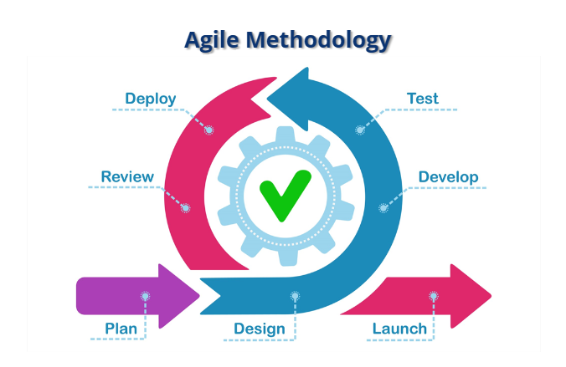
Phases of the Agile Approach
Citation 2

Slide 3
Planning Phase:
Product Owner meets with client to discover client’s needs
Scrum Master builds team to fulfill product development
Design Phase:
Product Owner meets with users to find desired features
Scrum Master and Product Owner develop user stories and product backlog
Sprint Planning meeting is held to organize and rank user stories
Development and Testing Phase:
Daily stand-ups are held to assign tasks and go over features to be completed or worked on for the day
Tests are prepared to ensure features function as they are developed.
Deploy and Review Phase:
Product is completed
Product Owner checks features to ensure they’re in line with product backlog
Team meets to review successes and struggles
Launch Phase:
Product is released to the public and maintenance begins to keep product functional
New development cycle begins to add new features or alter existing ones

Slide 4
What if the Project was Developed Using Waterfall?
Waterfall is a more rigid methodology than agile according to some people (funny enough the textbook goes out of it’s way not to say that). “You will often hear people make the comparison between agile and waterfall. Many of those discussions are polarized and position them as competitive approaches… While that statement is generally true it’s an oversimplification.” (Citation 3)
The basic premise of Waterfall is that each stage moves to the next and doesn’t backtrack, this is where the idea of the inflexibility of Waterfall comes from. A key situation where this would have drastically affected the project was when the client wanted to change a key component of the project. If the project had been using the Waterfall methodology, theoretically the whole project would need to be scrapped and restarted from scratch. However, “In some other comparisons like this, the word waterfall refers to a general style of product management that obsessively emphasizes predictability and control over agility, and that’s just bad project management.” (Citation 4) Ultimately despite the common belief that Waterfall is inflexible the project would probably backtrack to the step where they can adjust the development to compensate for the change in desired features.

Slide 5
When to Choose Waterfall and When to Choose Agile
Ultimately the choice between Waterfall and Agile is not immediately apparent. While Waterfall emphasizes pre-planning and Agile focuses on Agility both methods can be used in just about any circumstance of software development. It can be argued that Waterfall, based on it’s plan-based approach is more suited towards an initial release of a product. Looking at modern game development it would appear that many companies are attempting to use Agile development and in the end getting stuck in development hell where the product is never actually released, War Thunder, for example, was in alpha for 5 years and beta for 11 years. You can also point to the fact that most games in the modern era are all pre-release asking users to chip in their money and time to help build a finished product. In effect, Waterfall may be the better method for releasing software. Agile’s strengths lends itself more to updating a product by adding new features or updating old ones as was the case with the SNHU travel project.

Slide 6
Citations
Source: Charles G. Cobb, 2015, The Project Manager's Guide to Mastering Agile : Principles and Practices for an Adaptive Approach https://web-p-ebscohost-com.ezproxy.snhu.edu/ehost/ebookviewer/ebook/bmxlYmtfXzkzNzAwOV9fQU41?sid=cb72d7ca-4382-4632-b944-d9a13c38d83f@redis&vid=0&format=EB&lpid=lp_57&rid=0
Image Source: https://snhu-media.snhu.edu/files/course_repository/undergraduate/cs/cs250/storyline/mod1/story_html5.html
Source: Charles G. Cobb, 2015, The Project Manager's Guide to Mastering Agile : Principles and Practices for an Adaptive Approach, page 3 https://web-p-ebscohost-com.ezproxy.snhu.edu/ehost/ebookviewer/ebook/bmxlYmtfXzkzNzAwOV9fQU41?sid=cb72d7ca-4382-4632-b944-d9a13c38d83f@redis&vid=0&format=EB&lpid=lp_57&rid=0
Source: Charles G. Cobb, 2015, The Project Manager's Guide to Mastering Agile : Principles and Practices for an Adaptive Approach, page 4 https://web-p-ebscohost-com.ezproxy.snhu.edu/ehost/ebookviewer/ebook/bmxlYmtfXzkzNzAwOV9fQU41?sid=cb72d7ca-4382-4632-b944-d9a13c38d83f@redis&vid=0&format=EB&lpid=lp_57&rid=0

